Slide 1
Final Review 2 2018 exam questions
2019-12-05
Yaping Zheng
PhD in Accounting, McGill University
yaping.zheng@mail.mcgill.ca

Slide 2
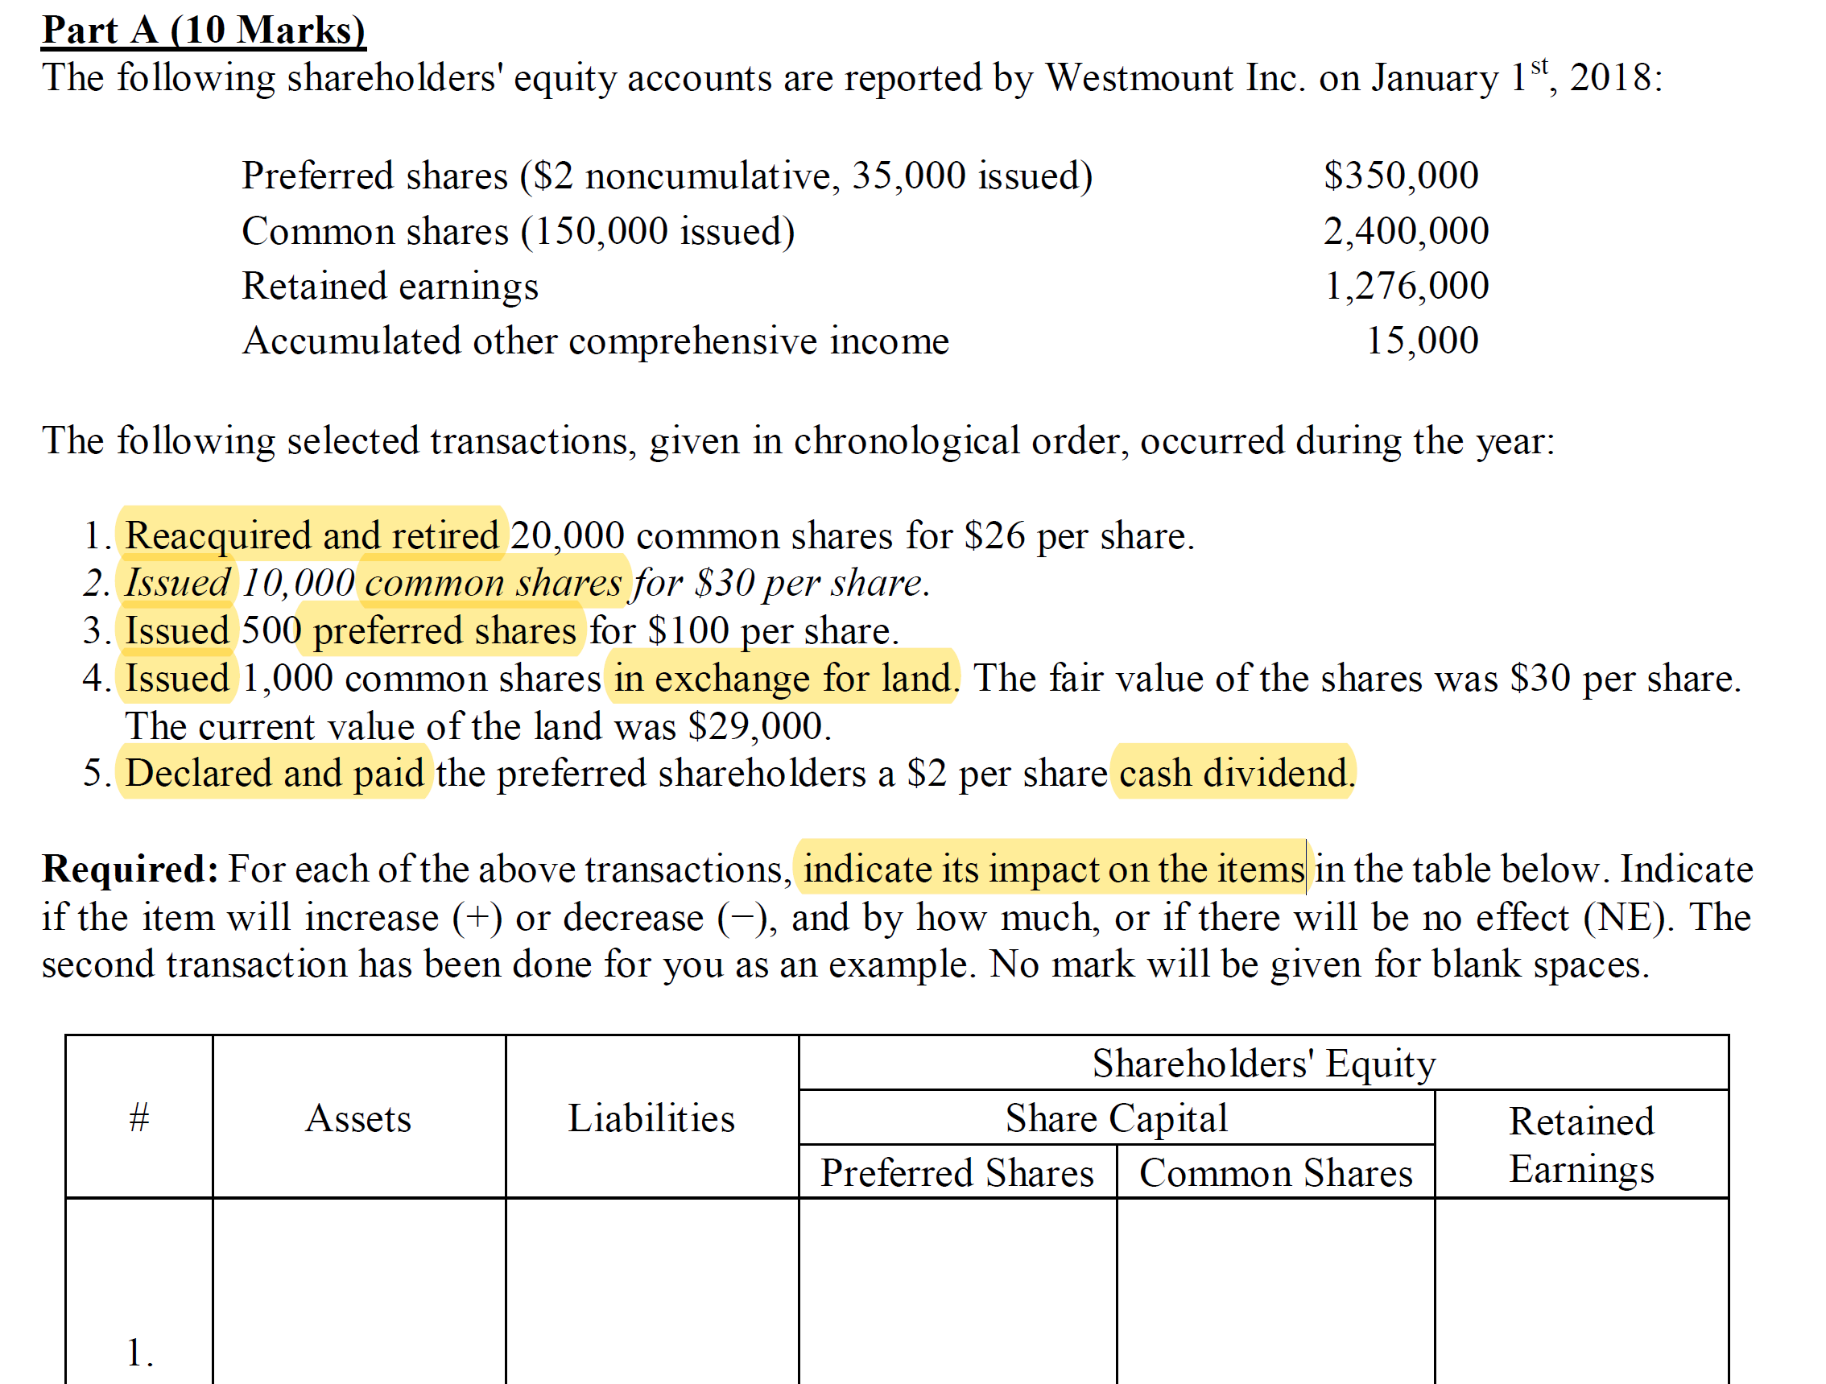

Slide 3
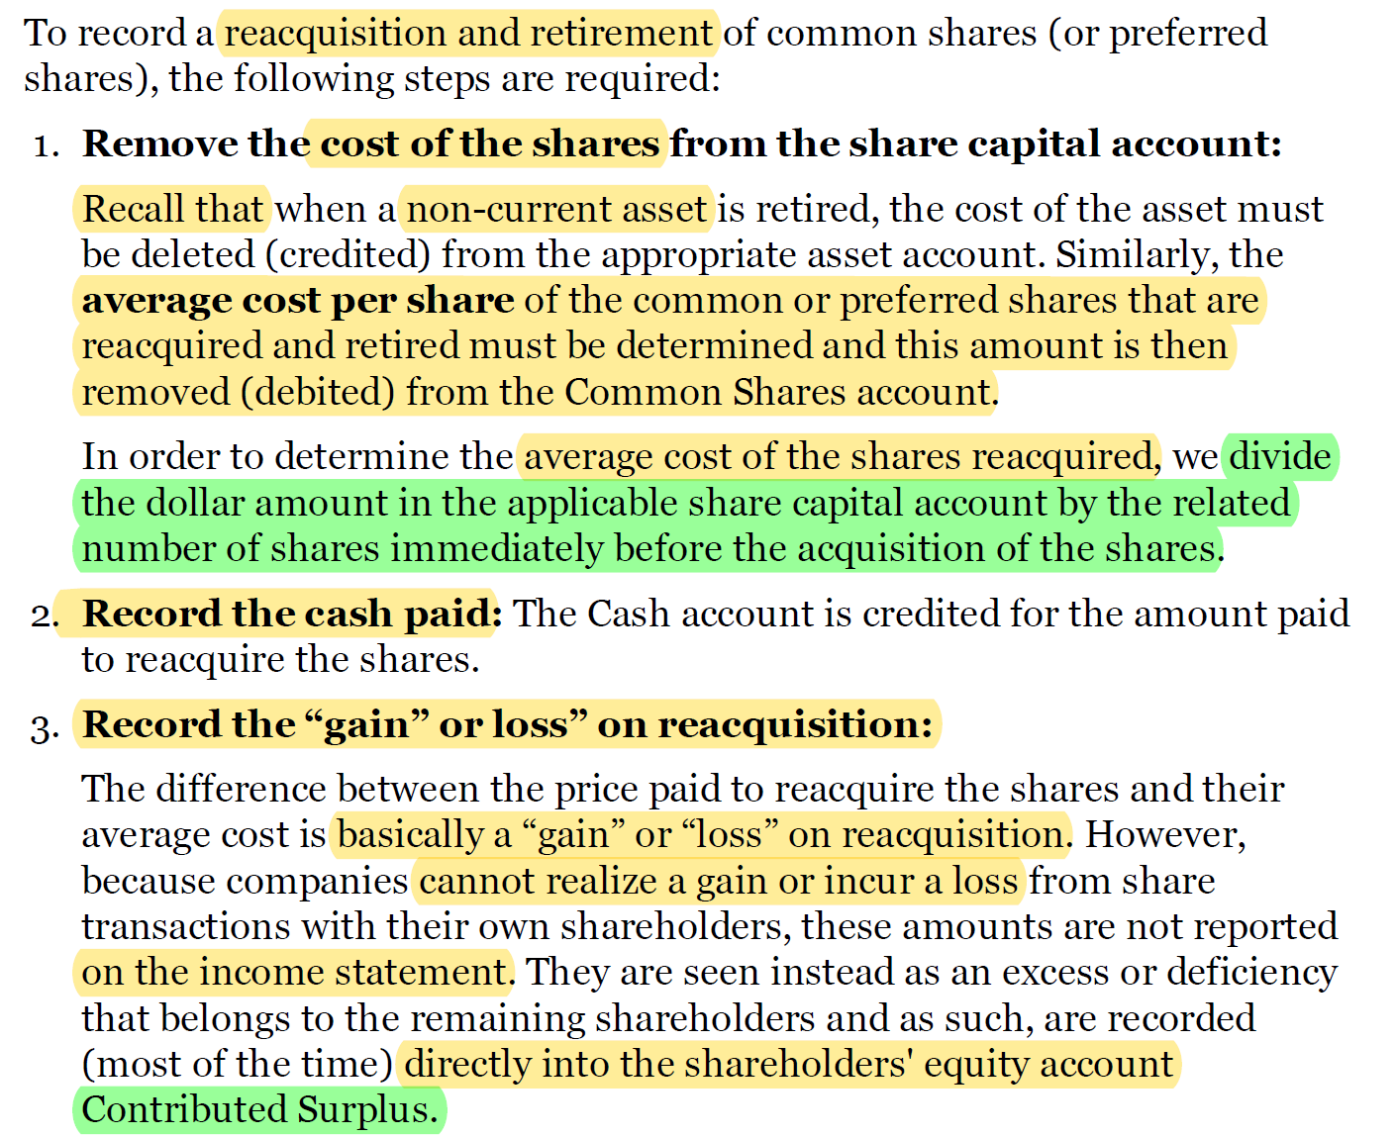

Slide 4
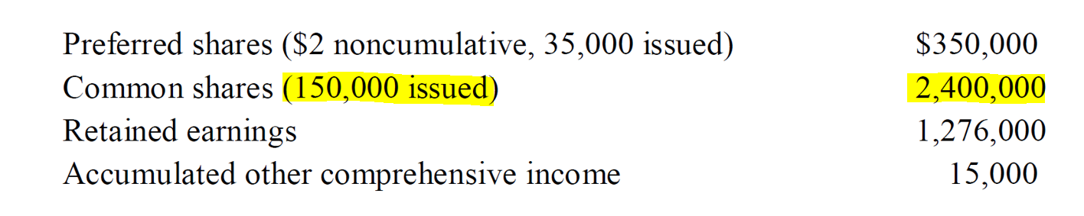
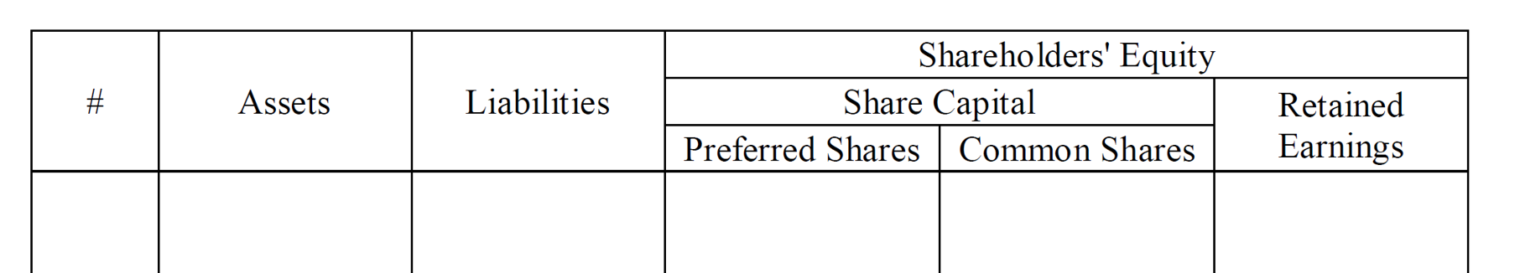
Average cost per share: 2,400,000/150,000 = 16 per share
Cost for 20,000 common shares: 20,000 * 16 = 320,000
Common shares 320,000
Retained earnings 200,000
Cash 520,000
- 520,000
- 320,000
- 200,000

Slide 5
Cash 300,000
Common shares 300,000
+300,000
+300,000

Slide 6
Cash 50,000
Preferred shares 50,000
+50,000
+50,000

Slide 7
When shares are issued for a noncash consideration, they should be recorded at the fair value of the consideration received.
If the fair value of the consideration received cannot be reliably determined, then the fair value of the consideration given up would be used instead.
Land 29,000
Common shares 29,000
+29,000
+29,000

Slide 8
Number of preferred shares issued: 35,000 +500 = 35,500
Cash divided: 35,500 * 2 = 71,000
Dividends declared 71,000
Dividend payable 71,000
Dividends payable 71,000
Cash 71,000
-71,000
-71,000

Slide 9
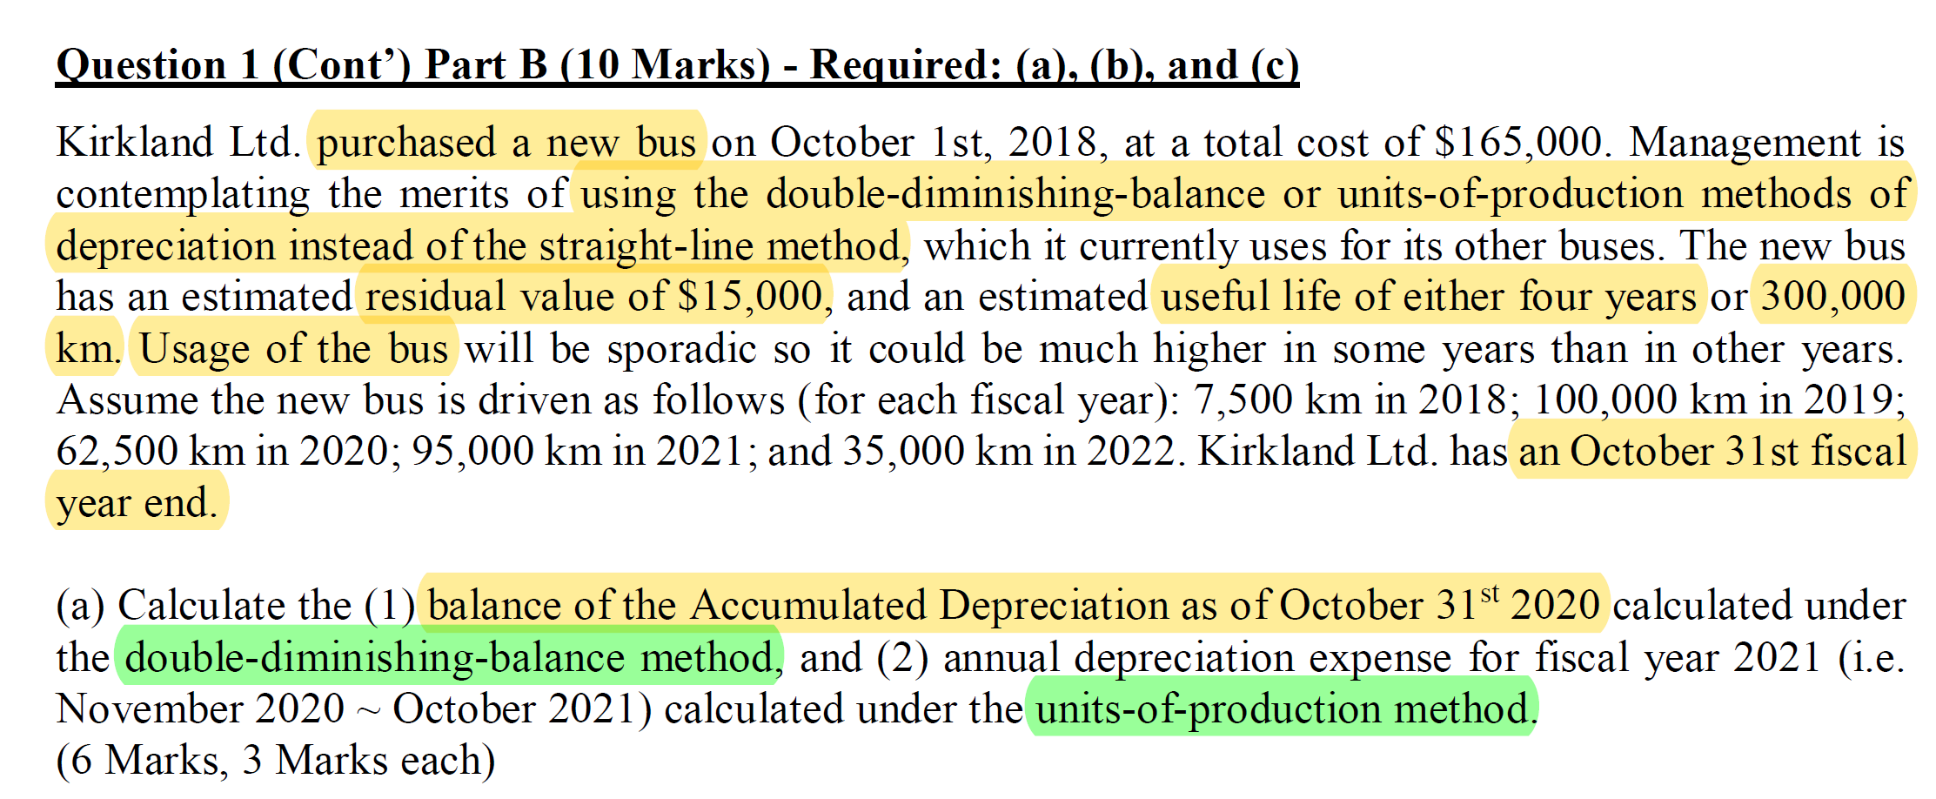
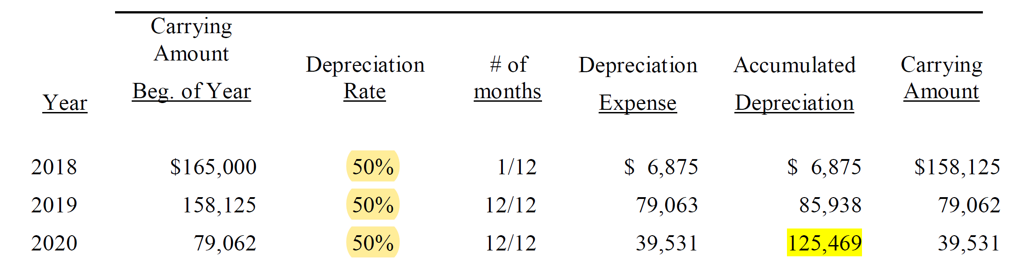
=¼ *2
=165,000*50%* 1/12
=165,000-6,875

Slide 10
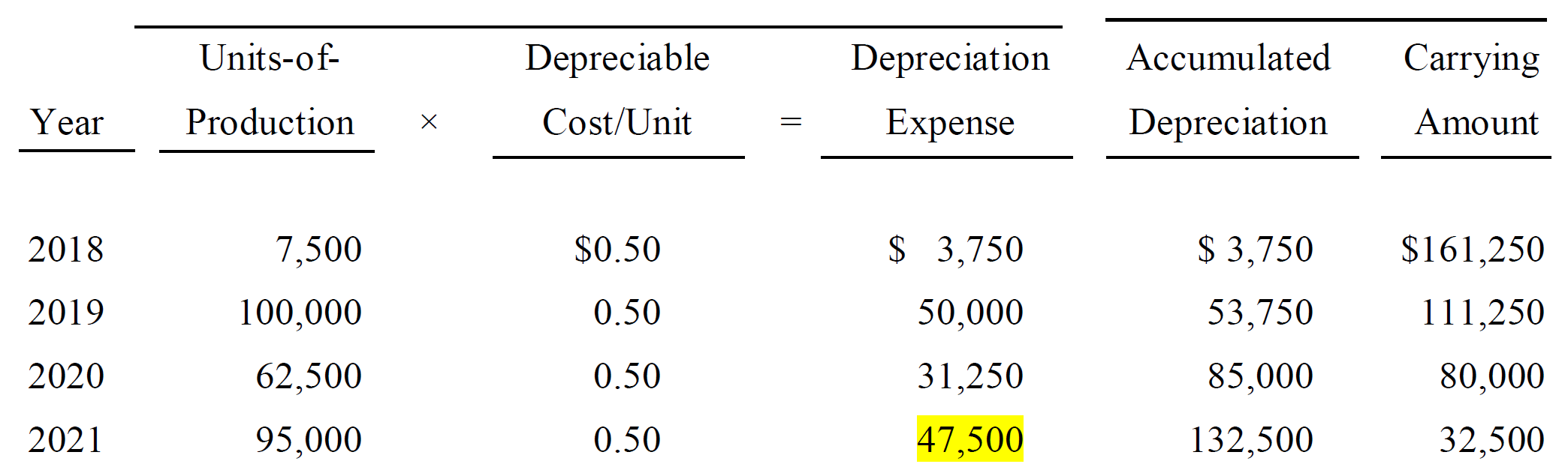
Unit cost = (165,000-15,000)/(7,500+100,000+62,500+95,000+35,000) =0.5

Slide 11
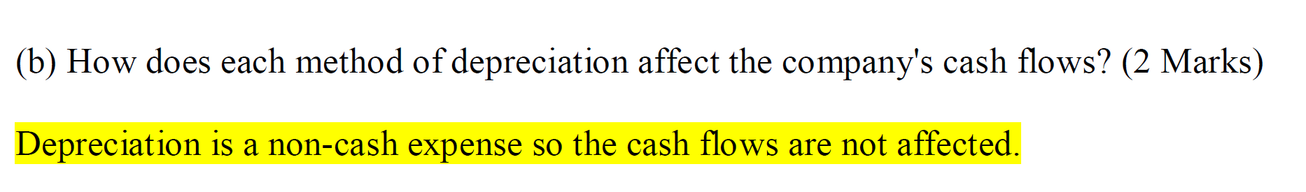
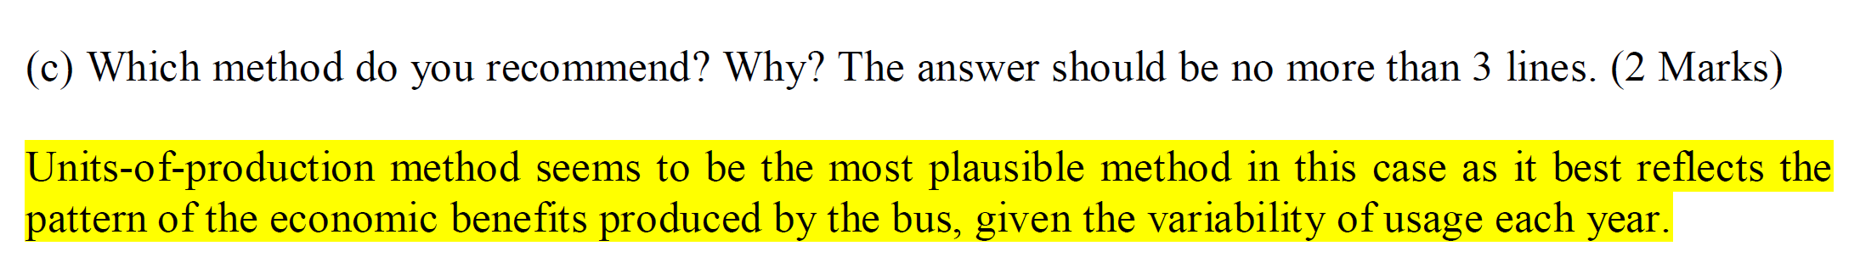

Slide 12
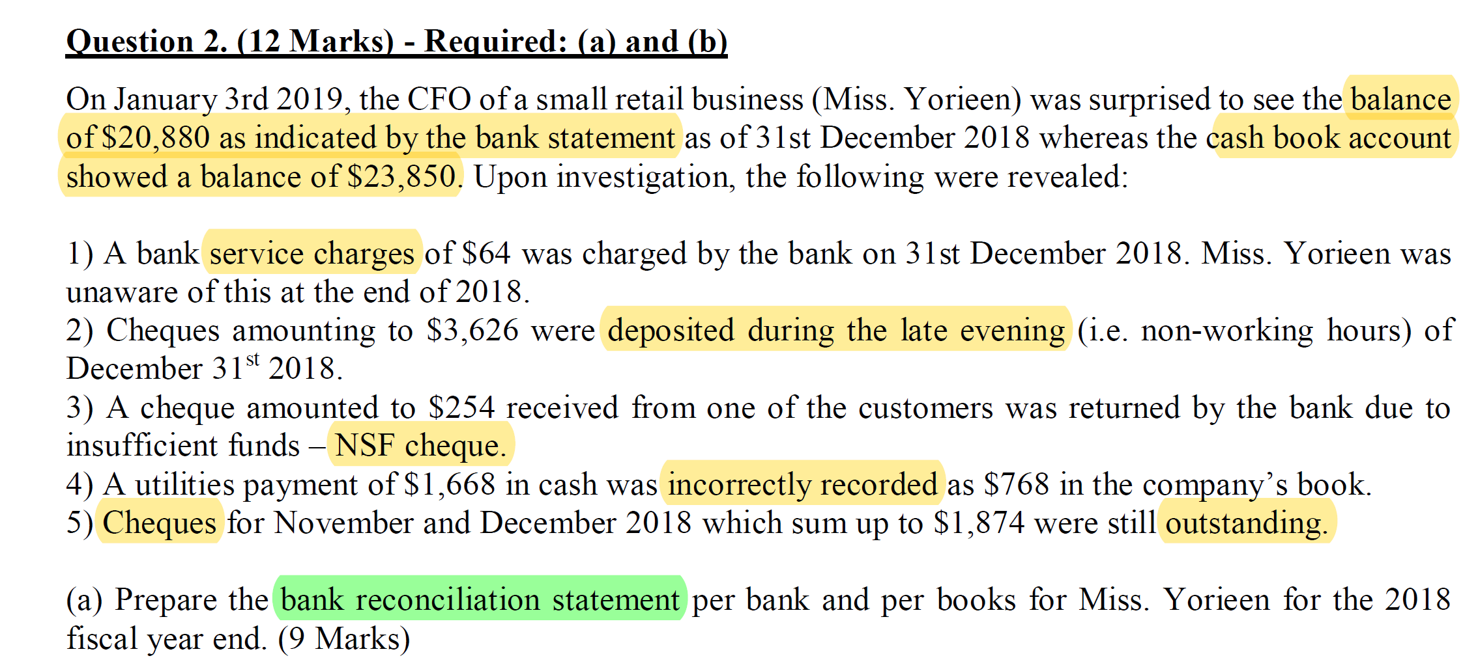

Slide 13
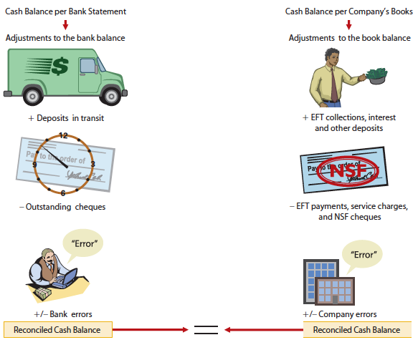

Slide 14
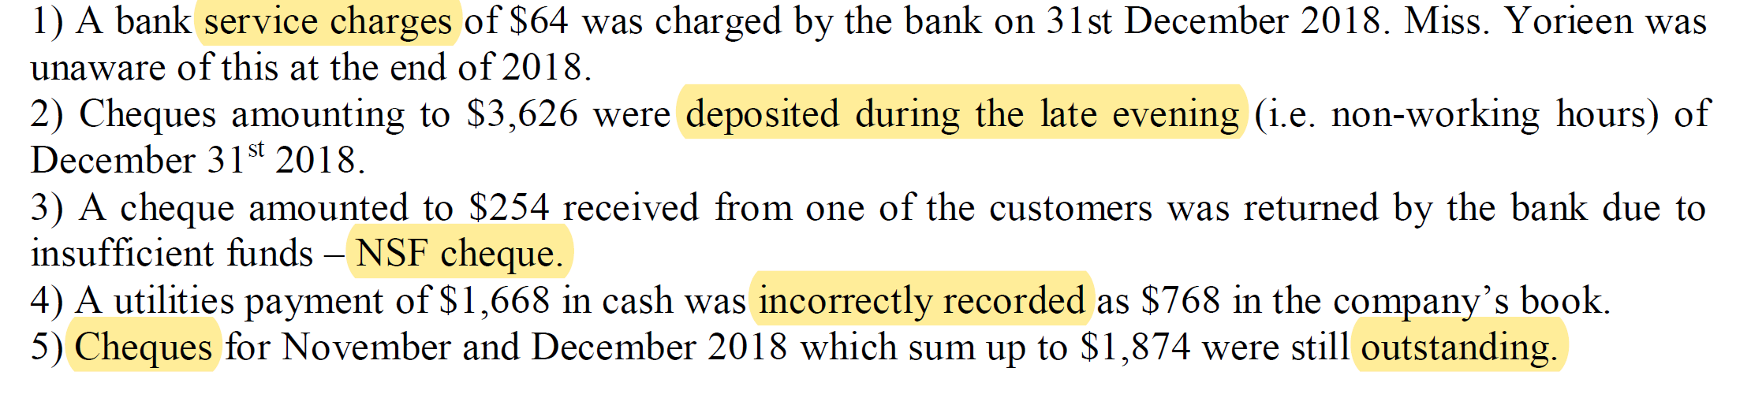
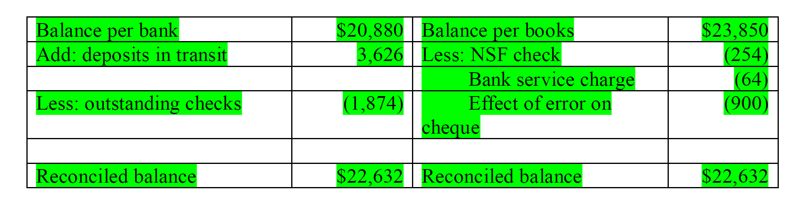
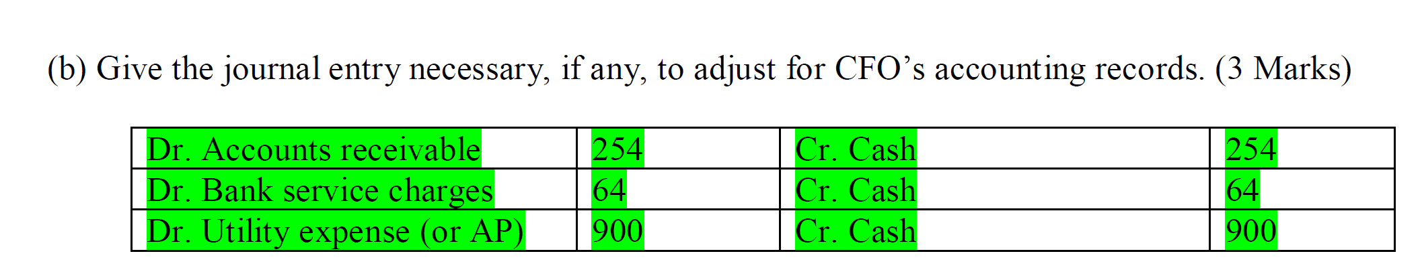

Slide 15
10 mins Break

Slide 16
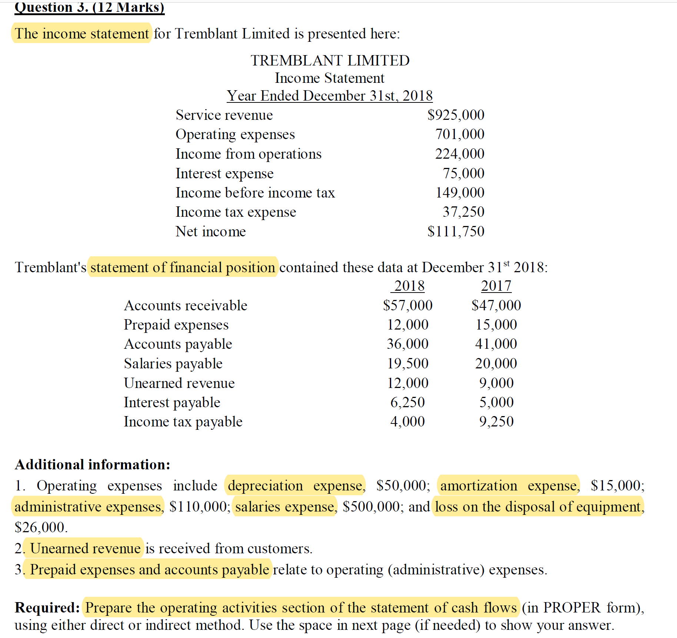

Slide 17
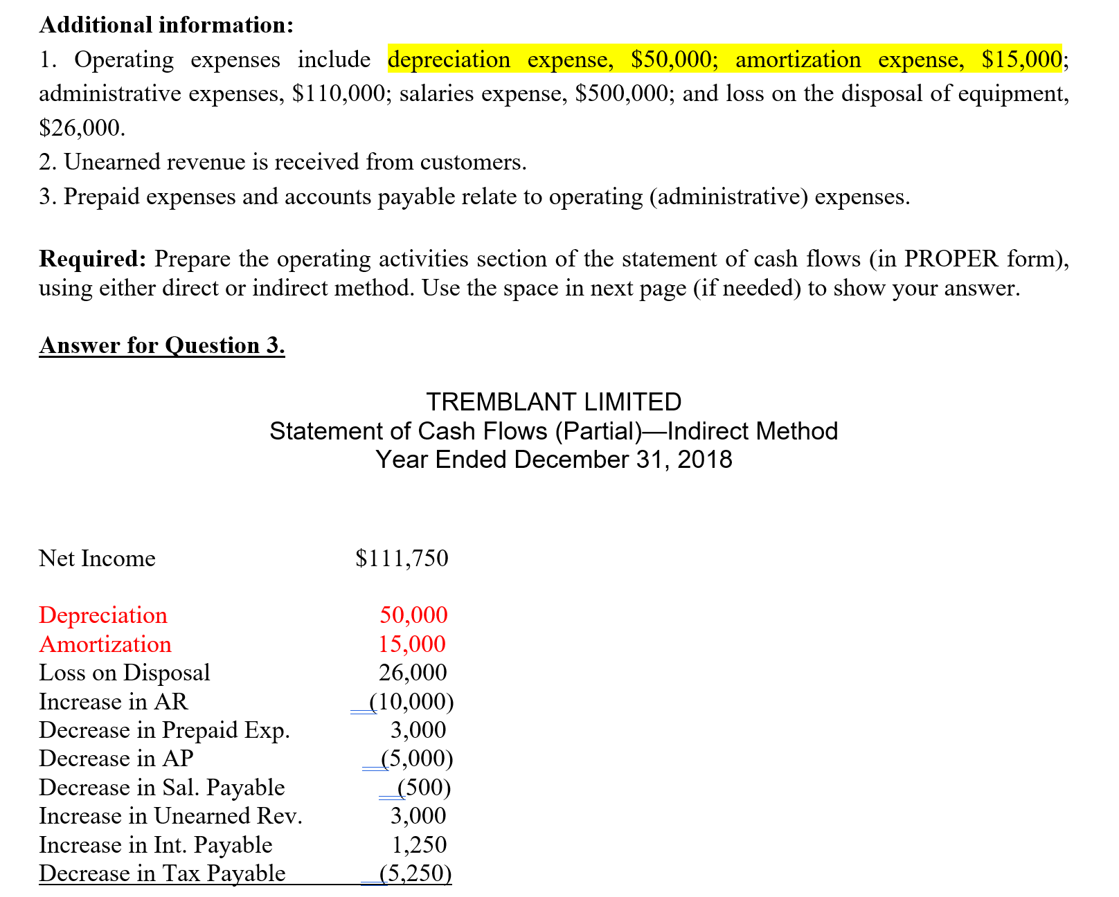
Non cash expense

Slide 18
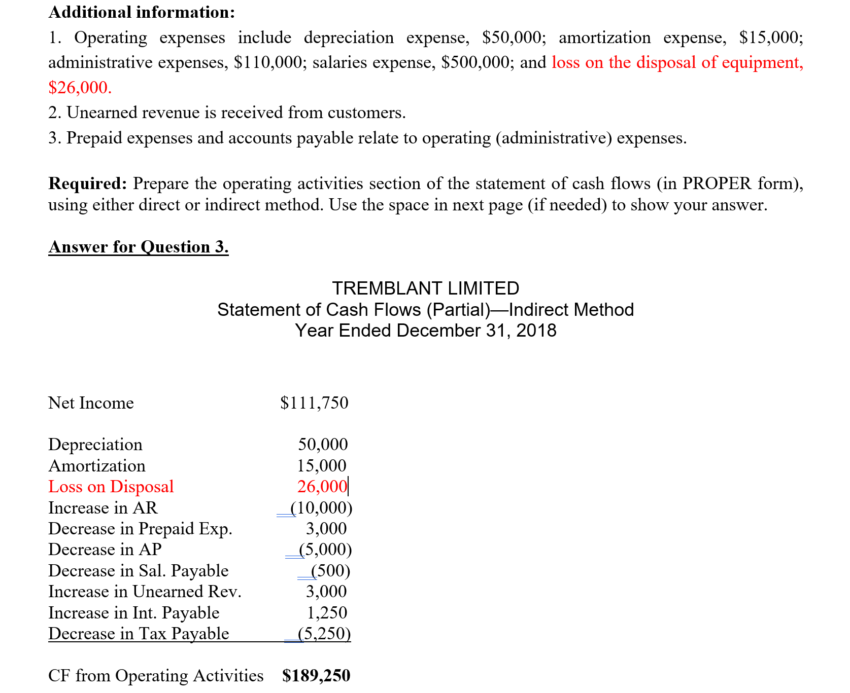
Investing activities

Slide 19
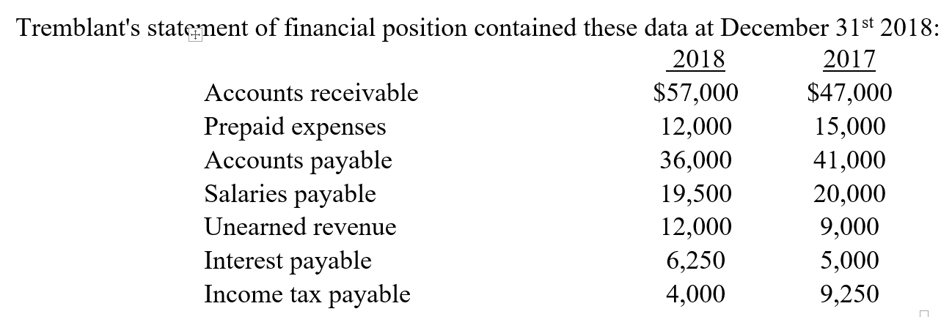
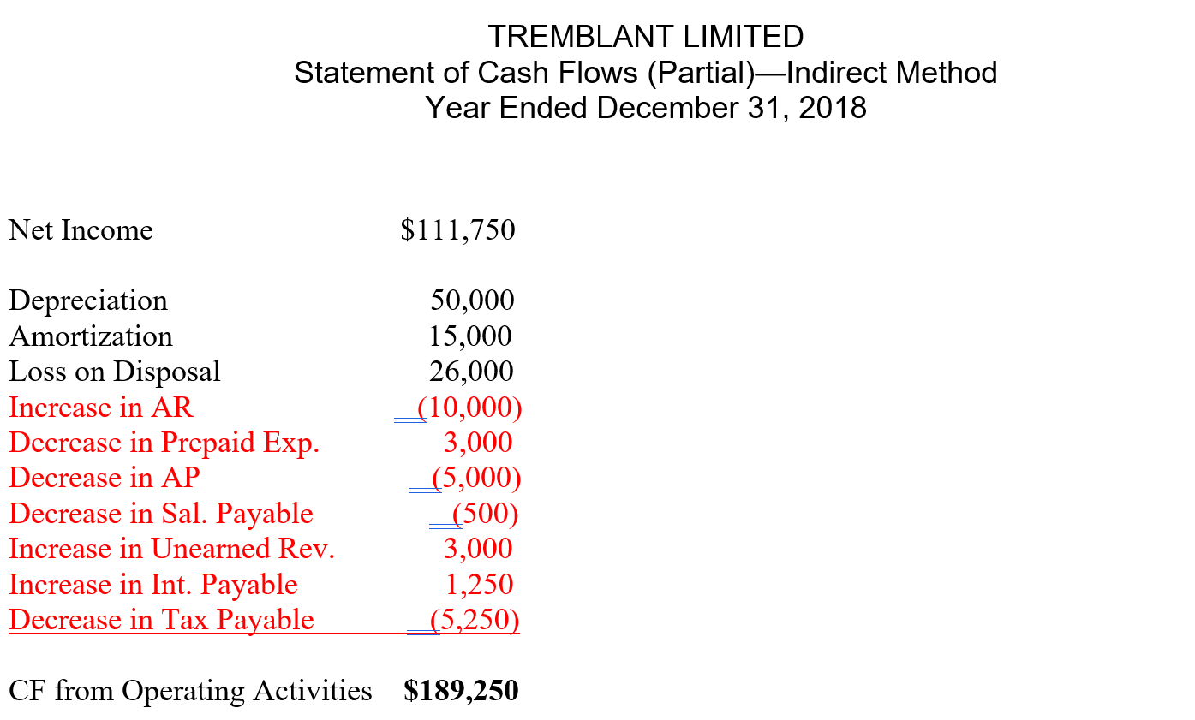
Changes in non-cash current assets and current liabilities

Slide 20
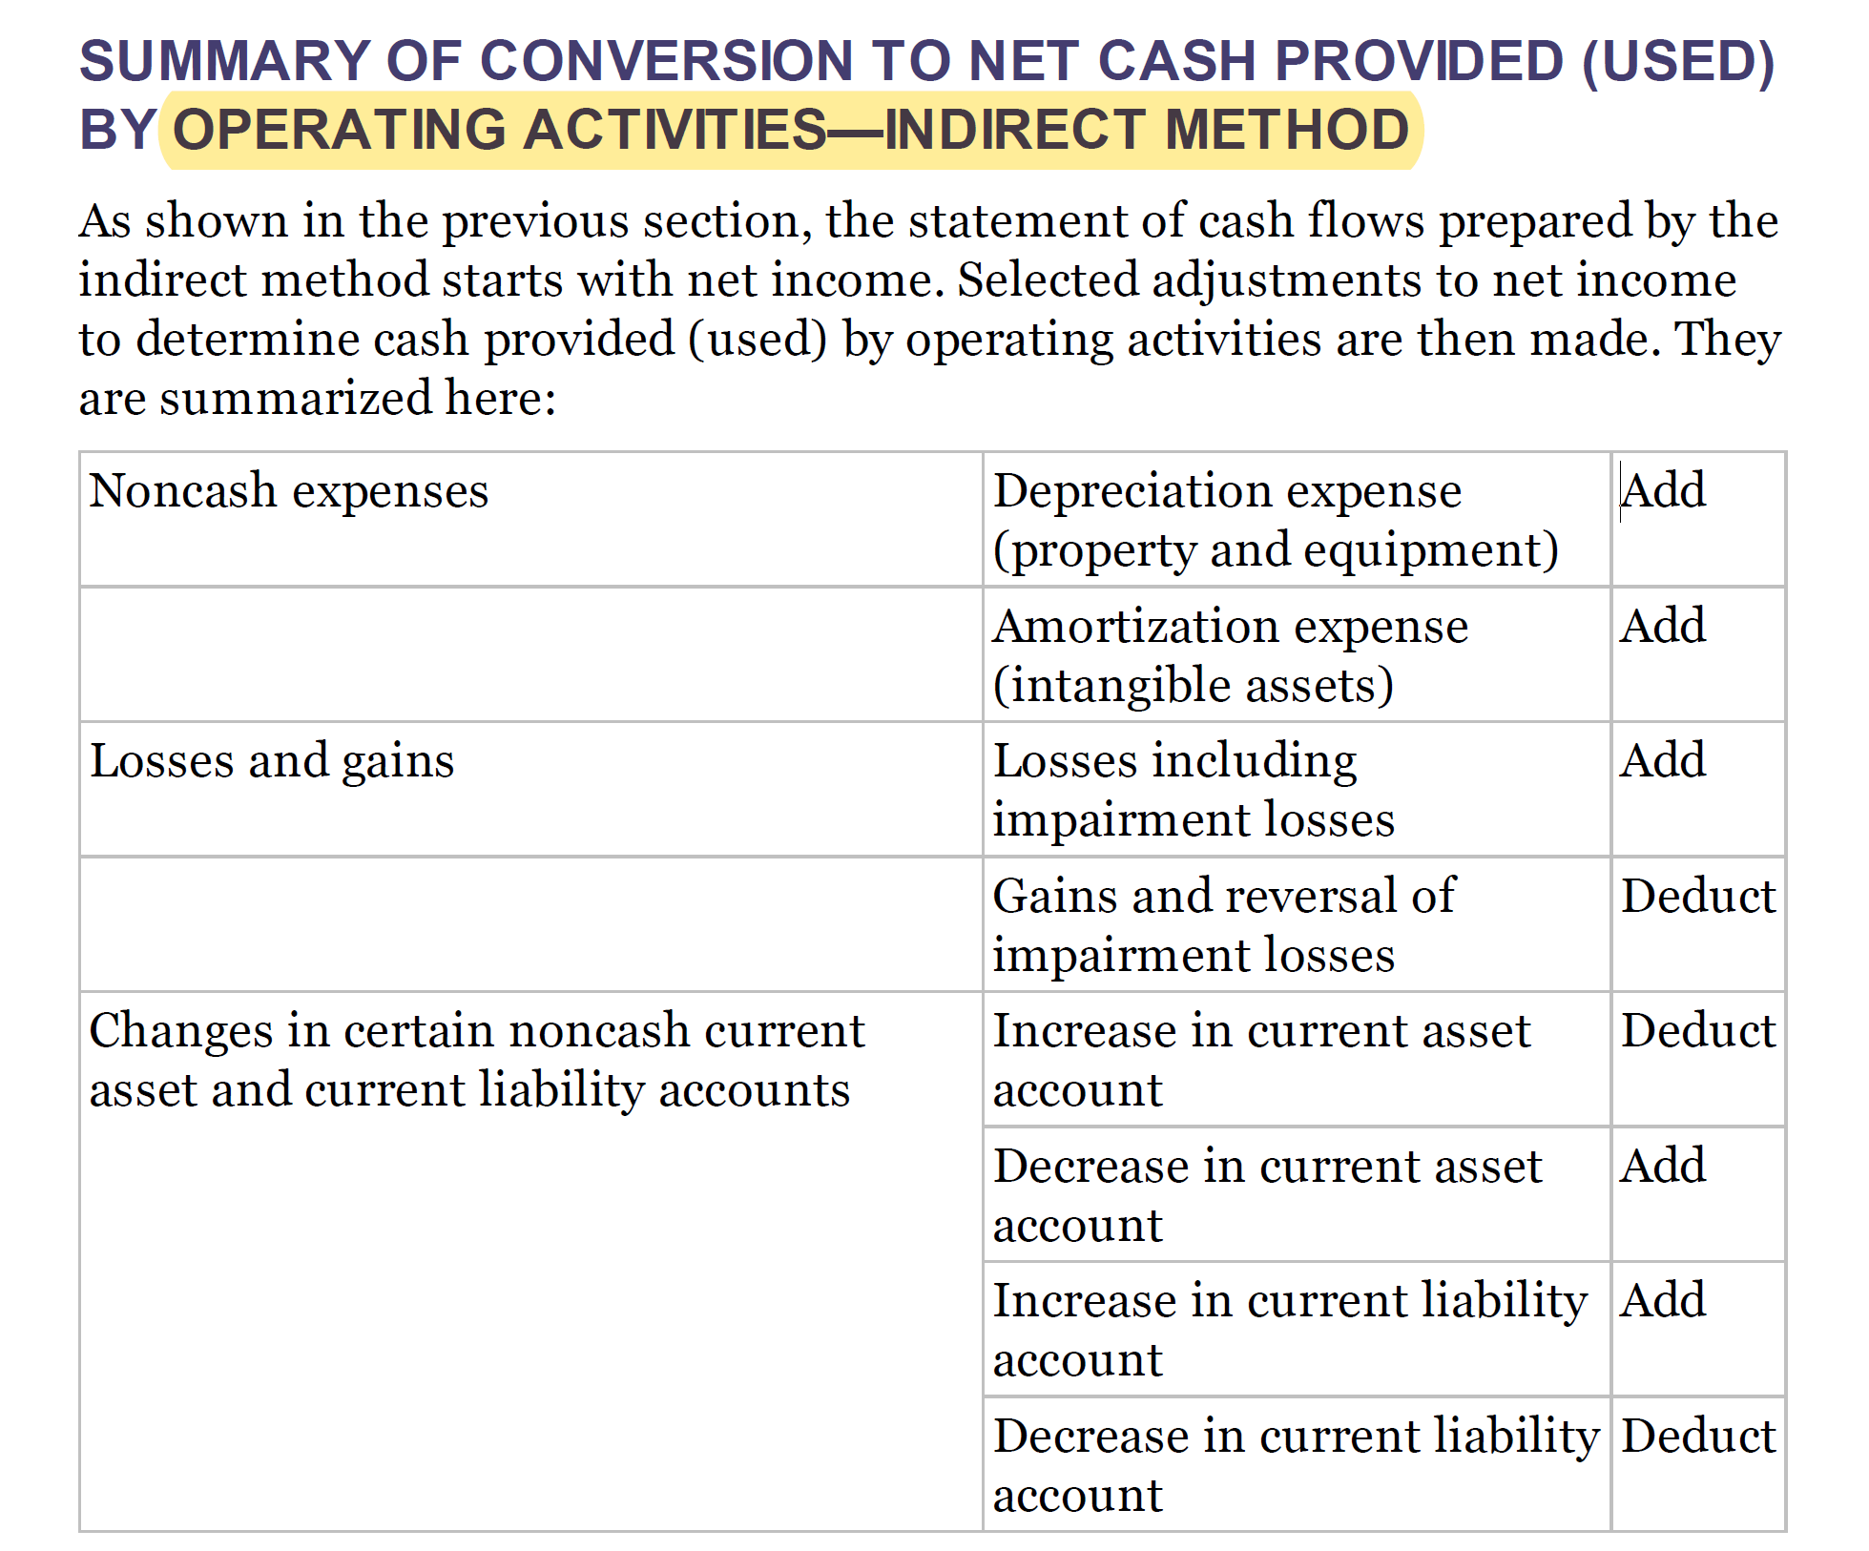

Slide 21
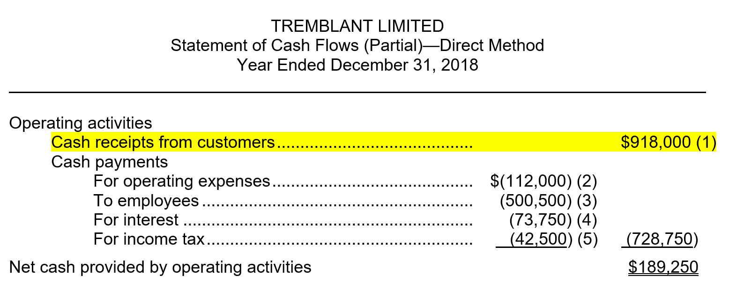
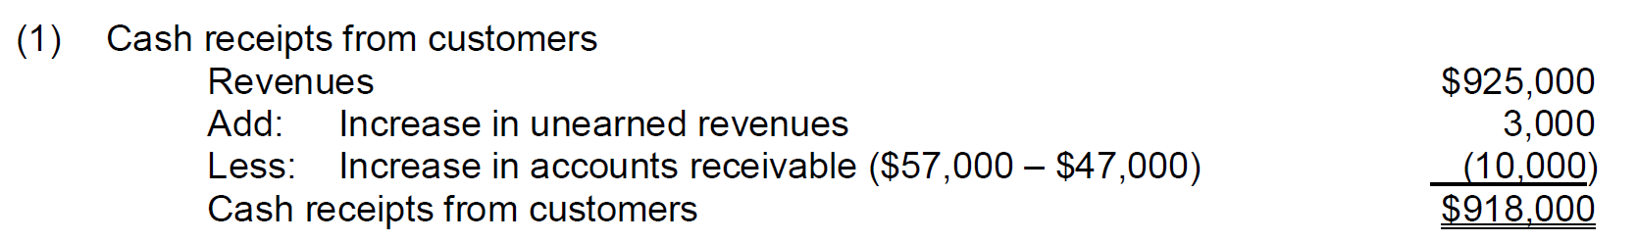

Slide 22
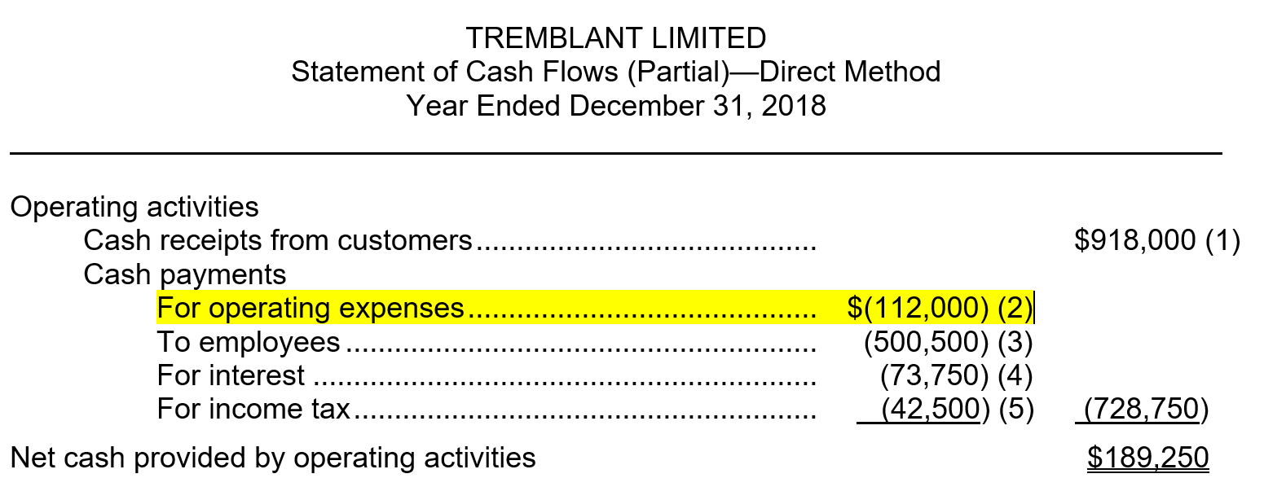
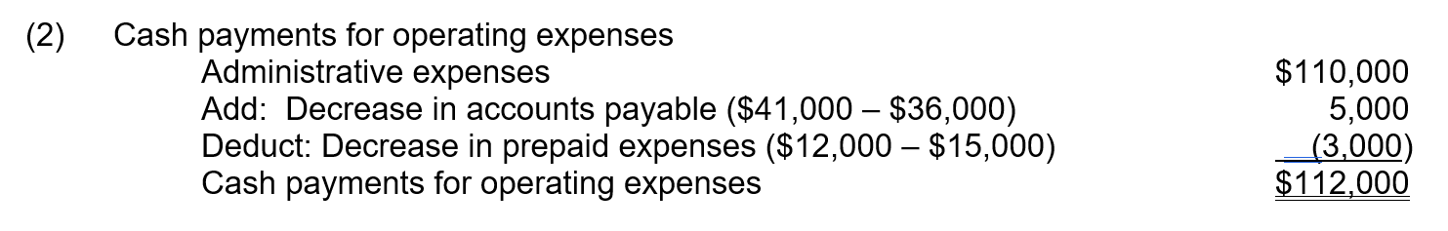

Slide 23
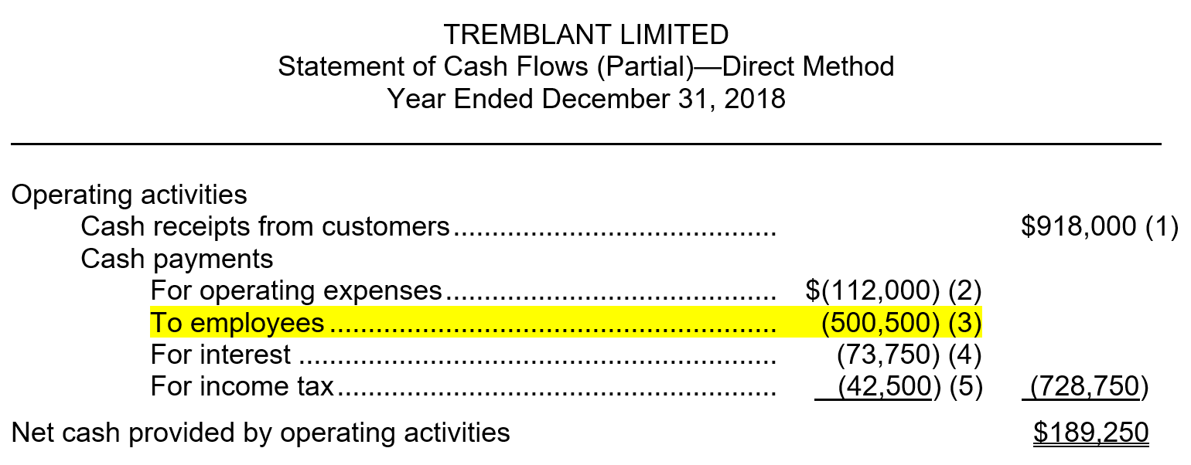
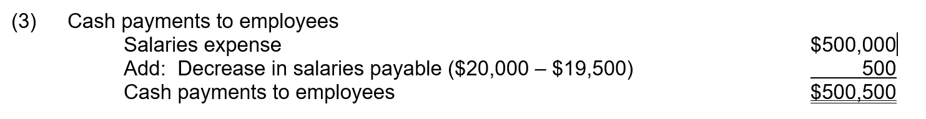

Slide 24
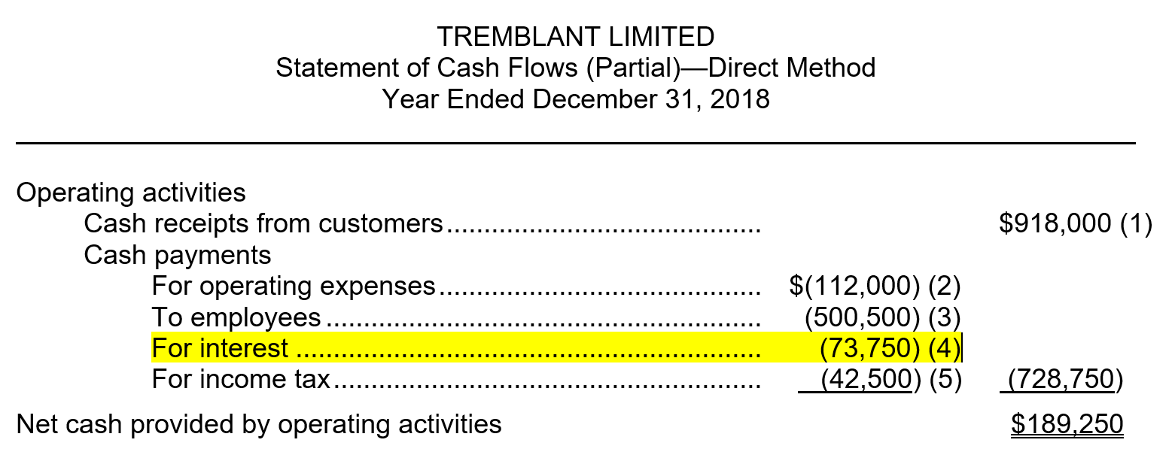
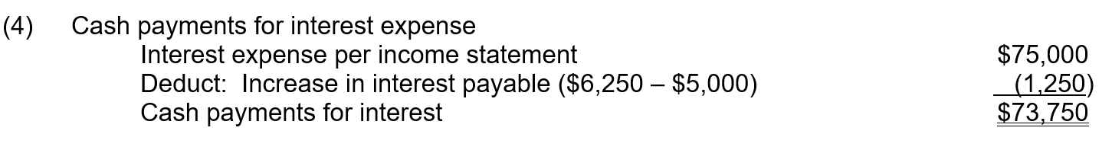

Slide 25
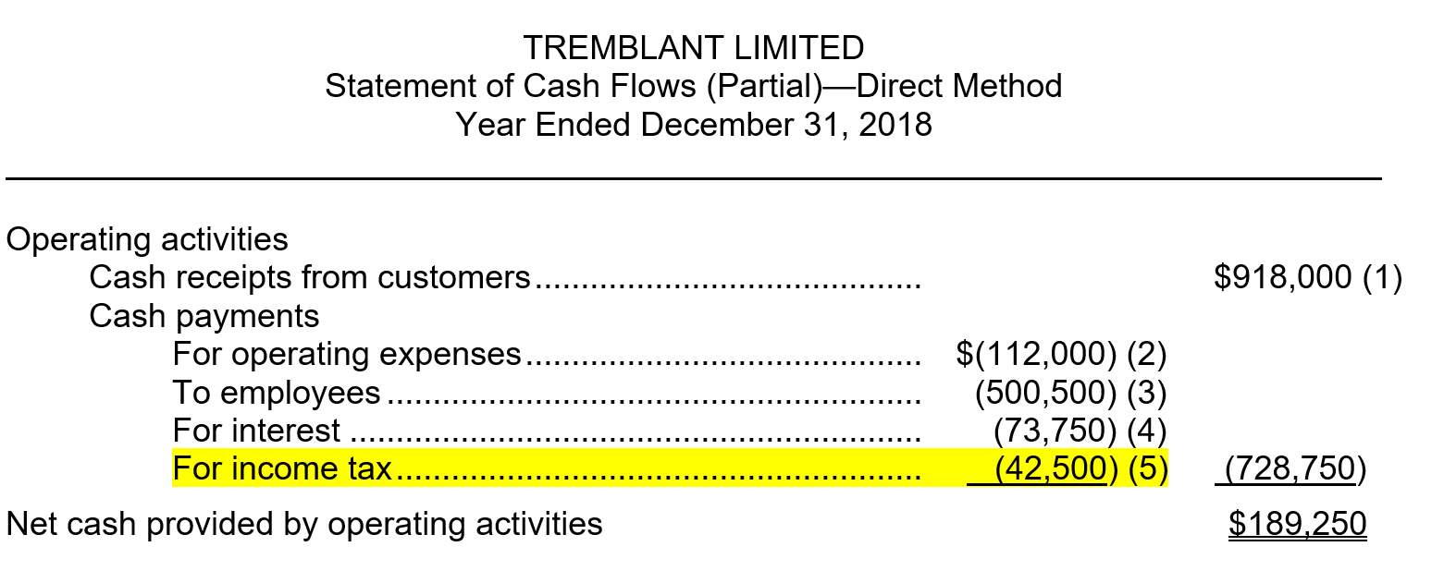
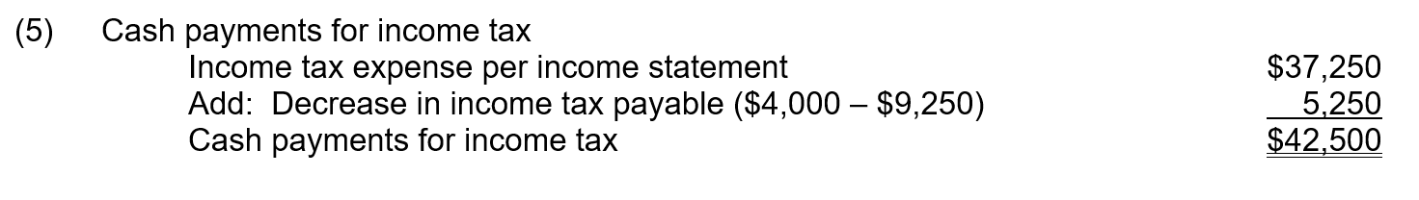

Slide 26
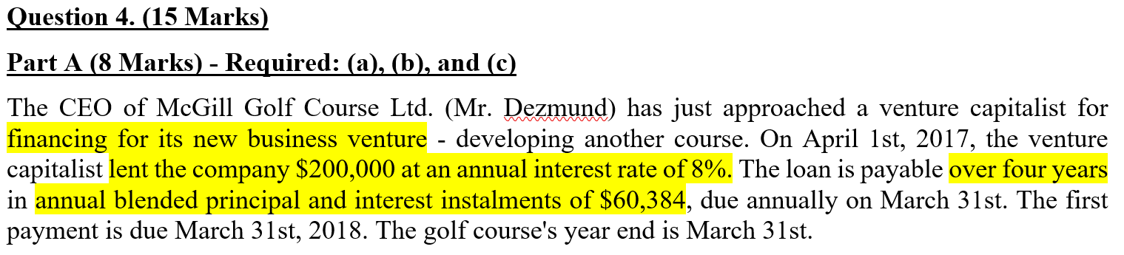
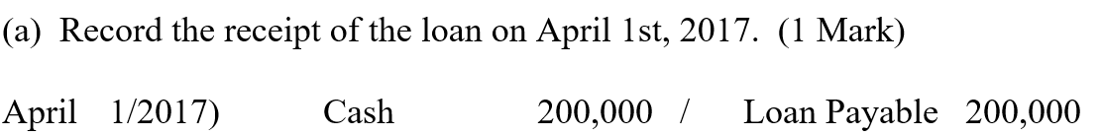

Slide 27
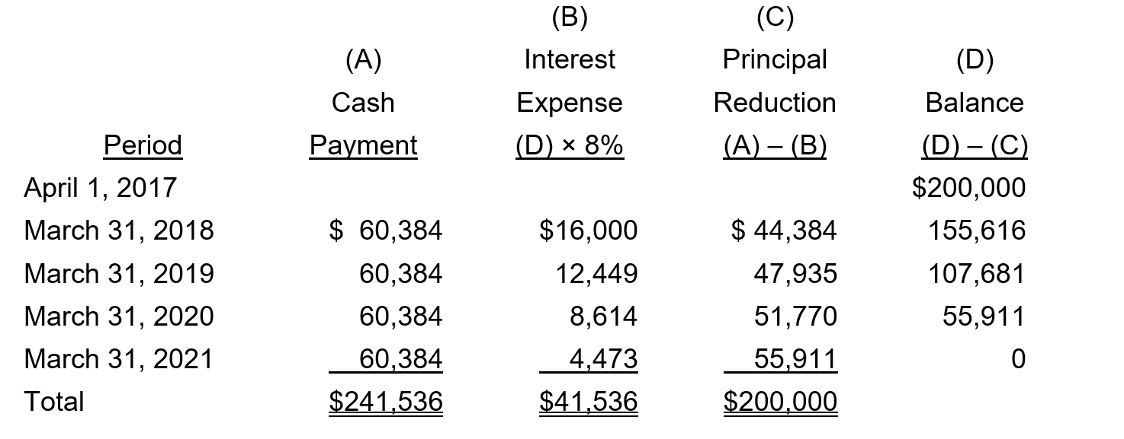
Blended principal: the cash payment for each month is equal

Slide 28
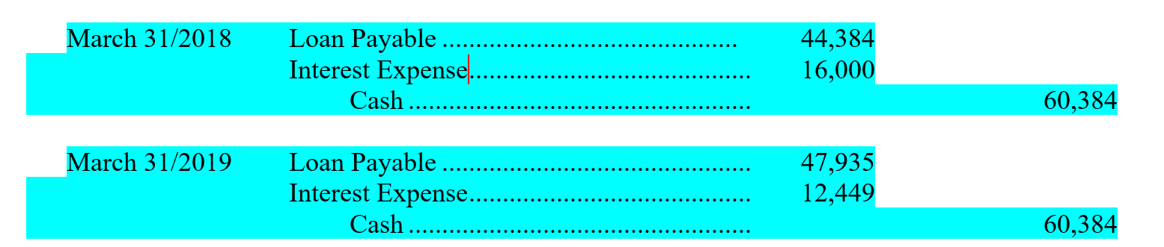

Slide 29
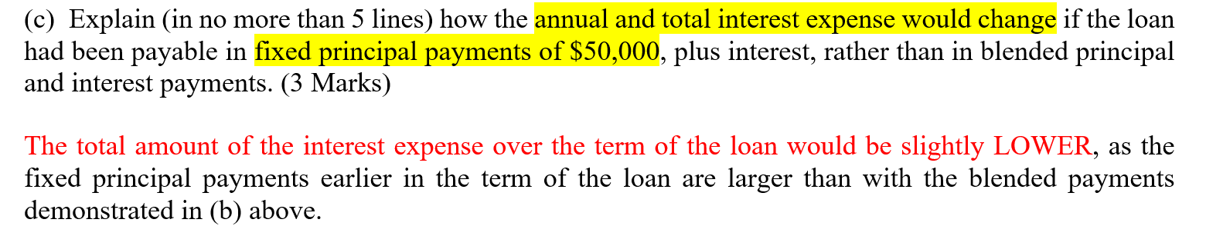
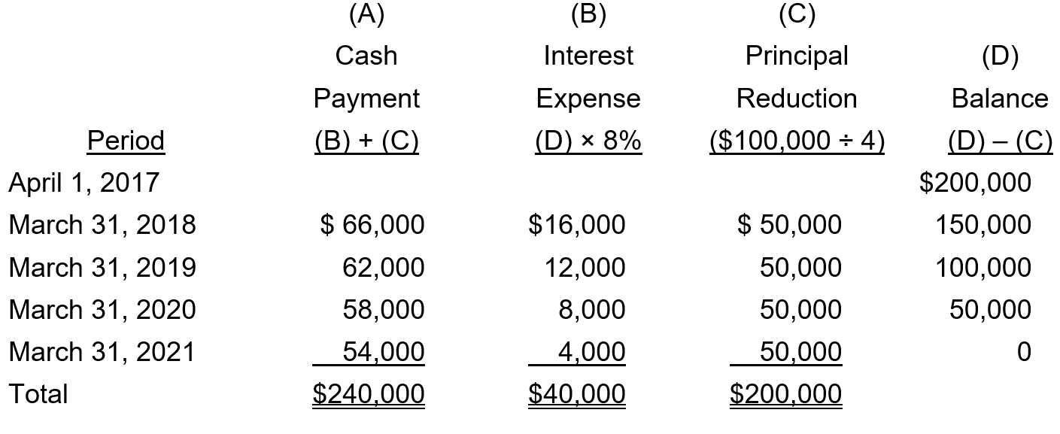
Fixed principal: paying equal principal every month

Slide 30
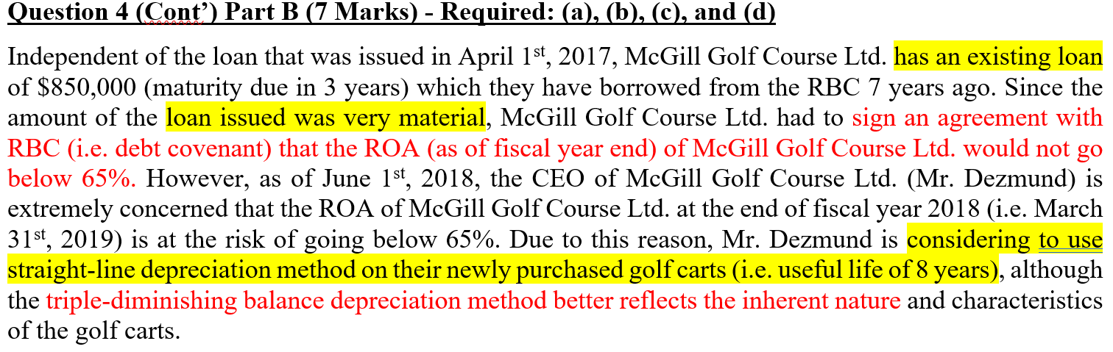
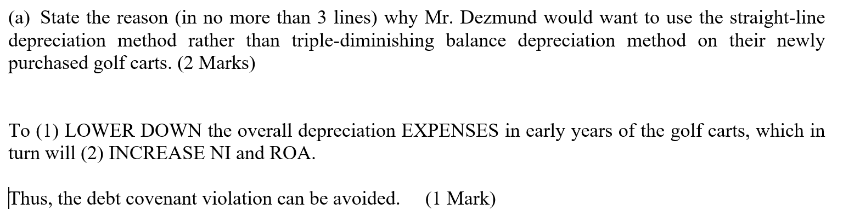

Slide 31
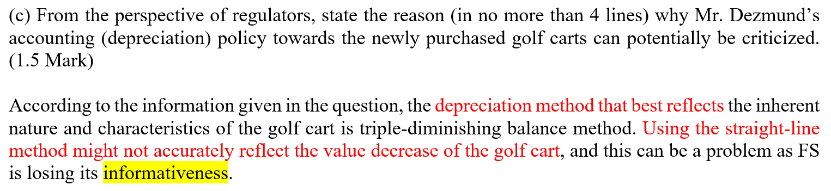
Yes. Income maximizing EM

Slide 32
10 mins Break

Slide 33
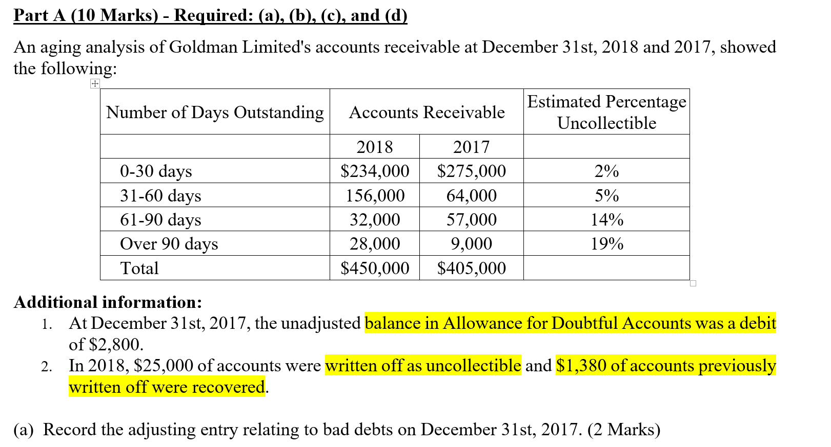
Targeting AFDA: 275,000*2% + 64,000* 5% + 57,000* 14% + 9,000* 19% = 18,390
Adjustment in AFDA: 2,800 + 18,390 = 21,190

Slide 34
AFDA
(b) Record the write off of uncollectible accounts in 2018.
Allowance for Doubtful Accounts 25,000
Accounts Receivable 25,000
(c) Record the collection of accounts previously written off in 2018.
Accounts Receivable 1,380
Allowance for Doubtful Accounts 1,380
Cash 1,380
Accounts Receivable 1,380
18,390
25,000
AFDA
18,390
25,000
1,380

Slide 35
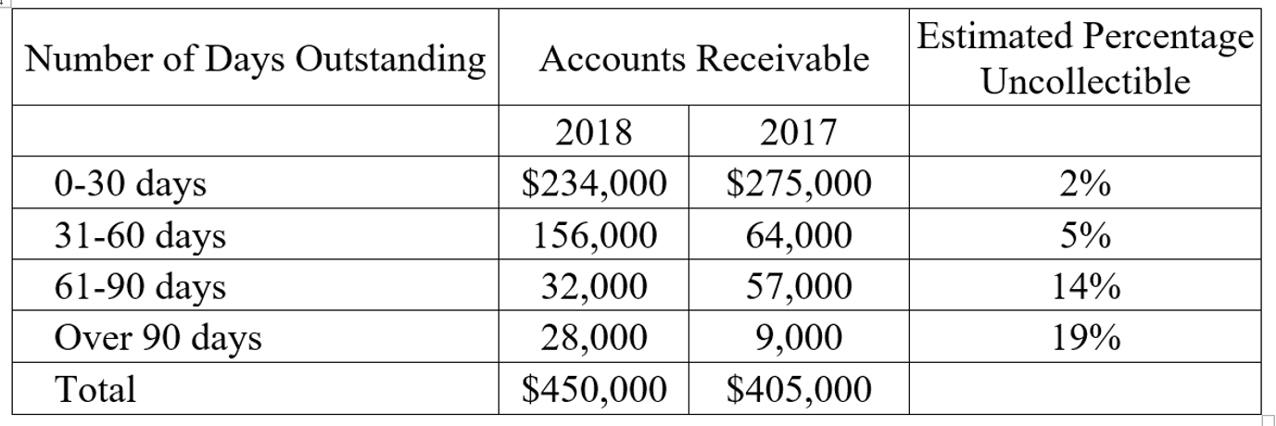
(d) Prepare the adjusting entry relating to bad debts on December 31st, 2018. (3 Marks)
Bad Debts Expense 27,510
Allowance for Doubtful Accounts 27,510
Targeting AFDA = 234,000* 2% + 156,000*5% + 32,000*14% + 28,000*19% = 22,280
Current AFDA balance: 5,230 (debit)
Adjustment to AFDA: 22,280 + 5,230 = 27,510
AFDA
AFDA
18,390
18,390
adjustment
25,000
25,000
1,380
1,380
27,510
5,230
22,280

Slide 36
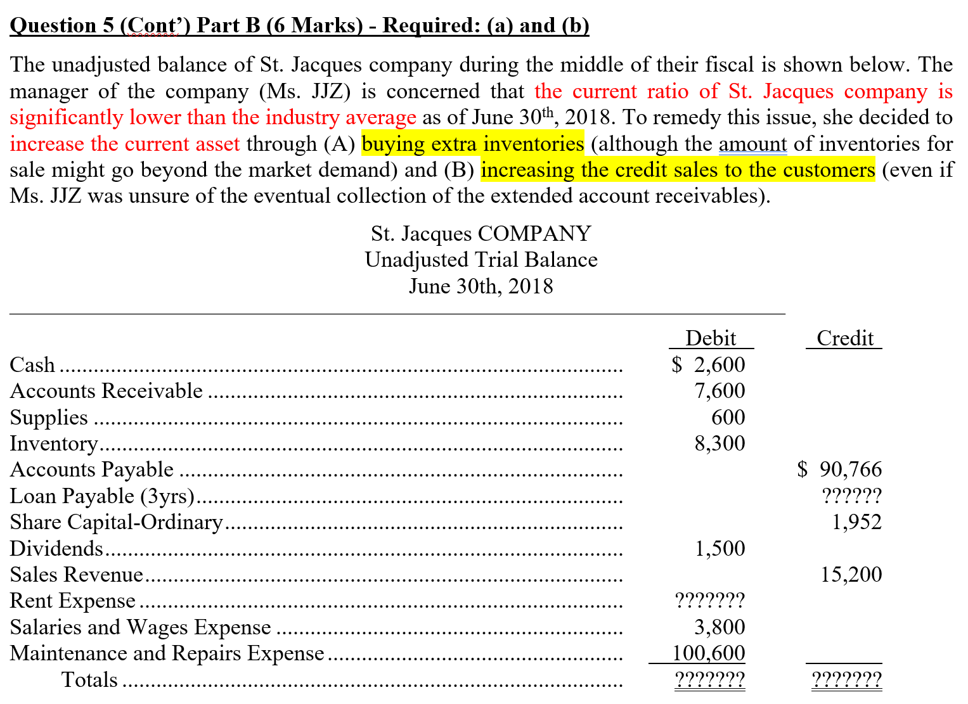

Slide 37
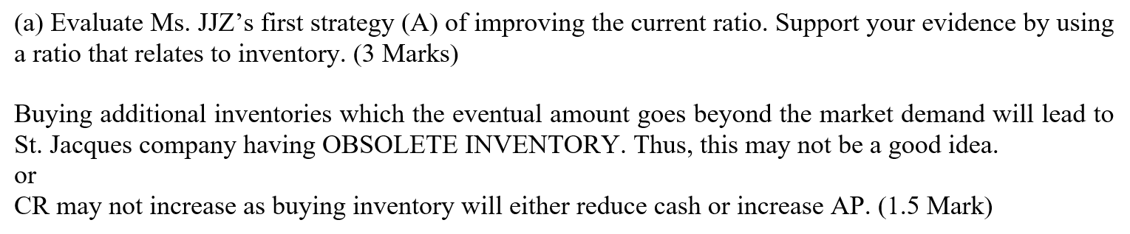
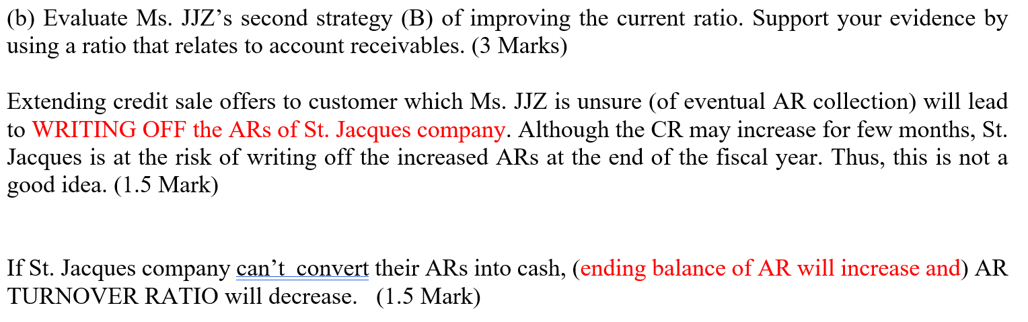

Slide 38
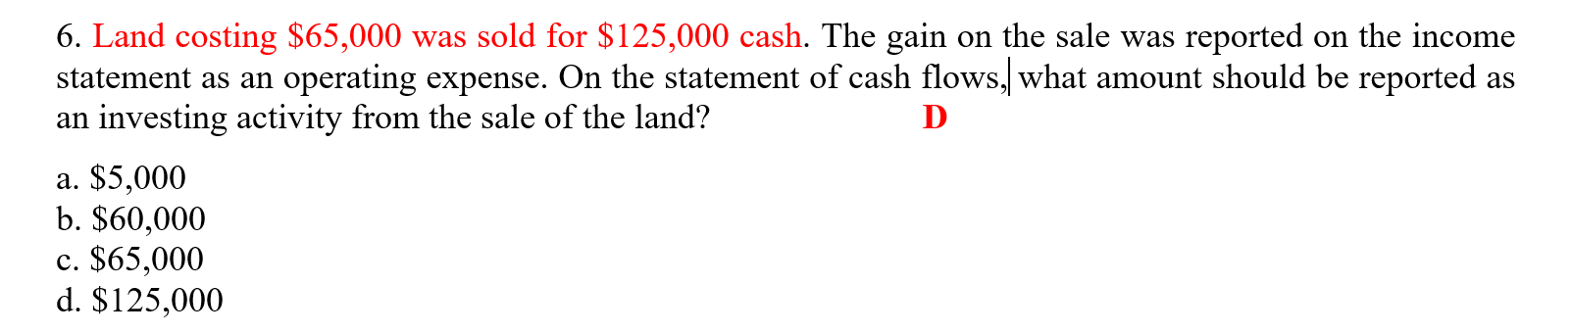
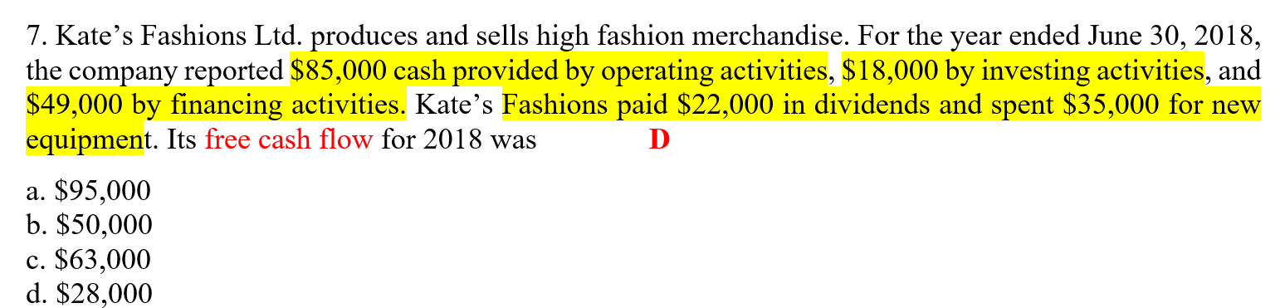
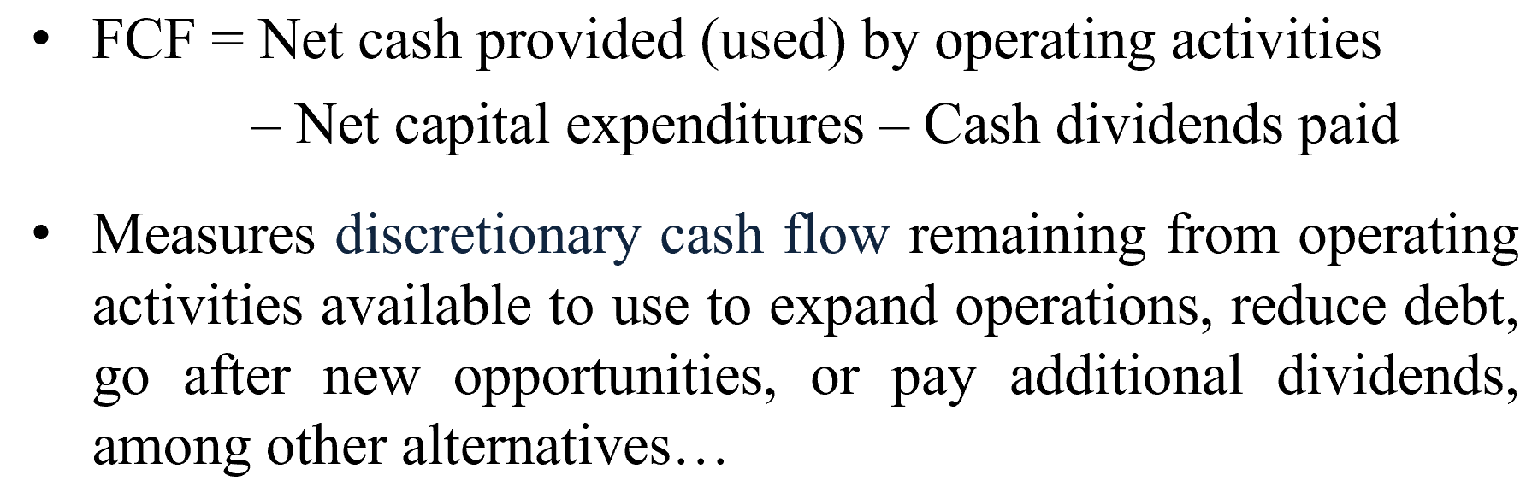
85,000 – 22,000 – 35,000 = 28,000

Slide 39
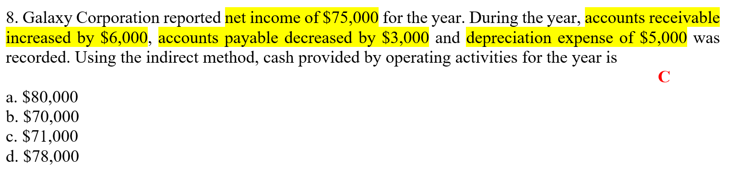
Net income + depreciation expense – increased AR – decreased AP
= 75,000 + 5,000 – 6,000 -3,000 = 71,000

Slide 40
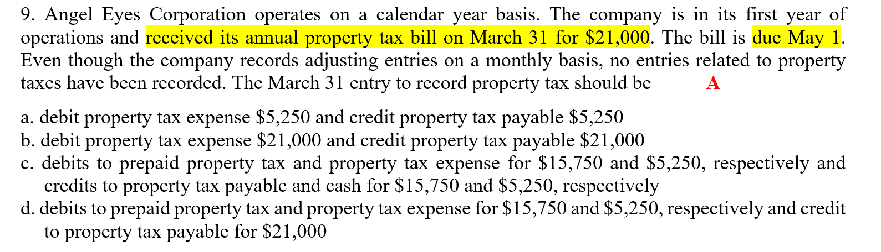
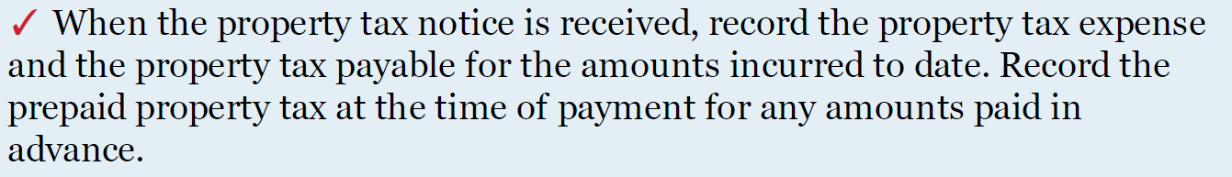
Mar 31 Property tax expense $5,250 (21,000*1/12*3)
Property tax payable $ 5,250
Mar 1 Property tax expense $1,750 (for April)
Property tax payable $5,250 (for Jan to Mar)
Prepaid property tax $14,000 (for other 8 months)
Cash $21,000
Dec 31 Property tax expense $14,000
Prepaid property tax $14,000

